Slide 1
perceptual constancy in hearing
speech played in a room, several metres from the listener
has much the same phonetic content as when played nearby
despite a substantial difference between the amounts of reflected sound
which gives different temporal envelopes to the two signals
this seems like a ‘constancy’ effect
- through a ‘taking account ‘ of reverb. in preceding context

Slide 2
or not?
Nielsen & Dau (2010) JASA 128, 3088-3094;
context effects with speech are ‘interference’
interference effects from preceding contexts are ubiquitous
- specifically, from modulation masking;
Wojtczak & Viemeister (2005) JASA 3198-3210
don’t arise from constancy

Slide 3
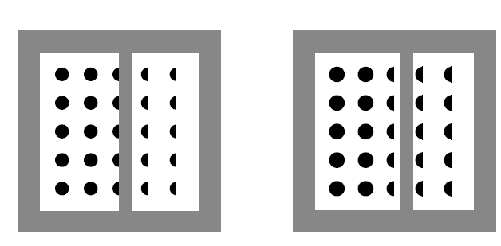


Palmer, S.E. Brooks, J.L. & Nelson, R. (2003)
When does grouping happen? Acta Psychologia, 114, 311-330
grouping after (visual shape) constancy
grouping before (visual shape) constancy

Slide 4
constancy effects are interference effects
for example, in the second demo;
- contexts interfere in that they distort the ovoid's perceived shape
and when hearing ‘takes account’ of the context’s reverb.
- contexts interfere in that they distort the subsequent words’ identities

Slide 5
interference effects on this time scale are not particularly ubiquitous
(in speech, ‘extrinsic’ effects, from beyond the syllable, tend to be weak)
forward modulation masking;
- does occur at high(ish) modulation frequencies (>20 Hz)
- unlikely to affect modulation frequencies important in speech (<16 Hz)
(Wojtczak & Viemeister, 2005)

Slide 6
the main sticking point for Nielsen & Dau;
if there’s no information from a preceding speech context;
- how come there appears to be compensation for effects of reverb?
however, compensation is likely to be the system’s ‘default’ setting
- i.e. it should ‘expect’ high(ish) reverb. in sounds when it’s in a room
- just as completion is the default in the first demonstration:

Slide 7
such behaviour is very common in perceptual systems
‘Bayesian’ approaches capture this;
- the general idea is that ‘prior’ probabilities influence what we see
for example, the probability that the middle column here is full dots is 0.5
- (10 full-dots on the left, and 10 half-dots on the right)
but the prior probability of a full dot is much greater than 0.5
- so we see the middle column as full dots
- and group accordingly

Slide 8
compensation for reverb. in speech seems similarly ‘Bayesian’
- i.e. compensation is effected when reverb. in test words is probable
the context’s reverb. largely governs this probability
but when there’s no context, prior probabilities are more influential
here, the perceptual system is in a room
- so the prior probability of a dry test word is low
- and the prior probability of a reverberant test word is higher
- so the relatively high probability of test-word reverb. → compensation

Slide 9
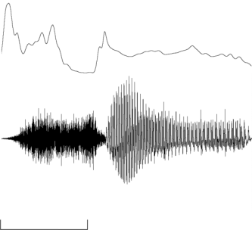
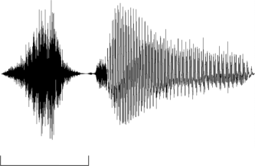

here, ‘sir’ vs. ‘stir’ test words
distinguished by the sounds’ temporal envelopes:
e.g. the gap in ‘stir’ before voicing onset
11-step continuum
end-point ‘stir’ (step 10)
from amplitude modulation of other end-point, ‘sir’ (step 0)
prominent effect of this AM is the gap
intermediate steps, 1-9, by varying modulation depth
AM function
amplitude
‘sir’
‘stir’
step 0
step 10
200 ms
200 ms
time

Slide 10
real-room reflection patterns:
taken from an office room, volume=183.6 m³
recorded with dummy-head transducers, facing each other
room’s impulse response obtained at different distances,
this varies the amount of reflected sound in signals i.e.:
early (50 ms) to late energy ratio: 18 dB at 0.32 m → 2 dB at 10 m
with an A-weighted energy decay rate of 60 dB per 960 ms at 10 m
impulse responses convolved with ‘dry’ speech recordings
headphone presentation → monaural ‘real-room’ listening

Slide 11
perceptual effects of room reflections:
from category boundary:
‘extrinsic’ context:
“next you’ll get _ to click on”
increase test-word’s distance:
more ‘sir’ responses, which increases category boundary
increase context’s distance as well:
‘perceptual constancy’ effect i.e.,
fewer ‘sir’ responses, which restores category boundary
1.
mean category boundary
mean proportion of ‘sir’ responses
.5
0.
0
5
10
“sir”
“stir”
continuum step

Slide 12
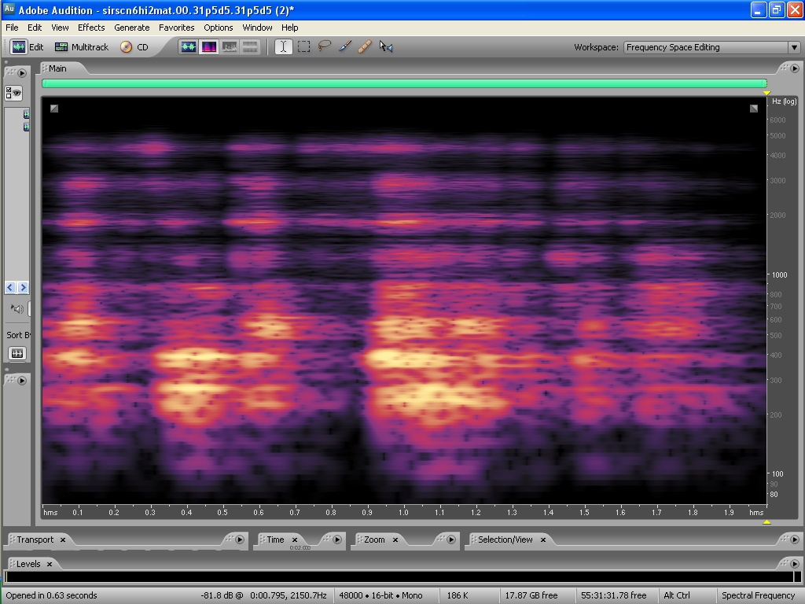

speech processed with an 8-band noise-excited vocoder
temporal envelope in each band from gammatone-filtered speech,
(η=4, and bandwidths= ‘Cambridge ERBs’)
each envelope applied to a (similarly) gammatone-filtered noise
band centre-frequencies in kHz = 0.25 x 2^{(7/12)(n-1)},
where n=band number, and n=1,2,…,8
4.
8
7
step 10
2.
6
5
grouping effect
1.
frequency, kHz (log scale)
4
.5
3
2
.25
1
step 0
n
300 ms
‘sir’
time

Slide 13
what is the relative importance of the different bands in the test word?
context held at 0.32 m throughout
n
test-word band varied between 0.32 m and 10 m
87654321
test-word band held at 0.32 m in all conditions
test word’s bands

Slide 14


n
W_{n, 1}
W_{n, 2}
. . .
W_{n, 6}
87654321
+1
-1
-1
-1
+1
-1
+1
-1
-1
-1
+1
-1
+1
-1
+1
-1
+1
+1
+1
-1
+1
-1
+1
+1
10
test dist.=10. m
test dist.=.32 m
S₅
category boundary, step
5
S₁
S₆
S₂
0
1
2
3
4
5
6
condition number (cond)
cond=6
Σ
importance of band n = S_{cond}W_{n,} _{cond}
cond=1

Slide 15
“sir” [sɜ], consonant & vowel ffts
20 dB
difference
consonant, [s]
vowel, [ɜ]
1
2
3
4
5
6
7
8
band no.
.125
.25
.5
1.
2.5
5.
frequency, kHz (log scale)

Slide 16
what is the relative importance of the different bands in the context?
all test-word’s bands varied between 0.32 m and 10 m
n
context band varied between 0.32 m and 10 m
87654321
context band held at 0.32 m in all conditions
context’s bands

Slide 17



n
W_{n, 1}
W_{n, 2}
W_{n, 6}
87654321
+1
-1
-1
-1
+1
-1
+1
-1
-1
-1
+1
-1
+1
-1
+1
-1
+1
+1
+1
-1
+1
-1
+1
+1
10
cond=1
cond=2
cond=3
cond=4
cond=5
cond=6
test dist.=10. m
test dist.=.32 m
category boundary, step
5
S_{a, 1}
S_{a, 2}
S_{b, 2}
S_{a, 6}
S_{b, 1}
S_{b, 6}
0
.32
.32
10.
.32
10.
.32
10.
10.
.32
10.
.32
10.
context’s distance, m
cond=6
Σ
importance of band n = (S_{a, cond} - S_{b, cond}) W_{n,} _{cond}
cond=1

Slide 18
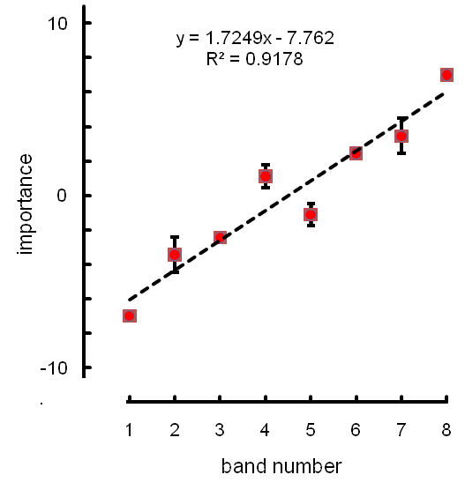
“sir” [sɜ], consonant & vowel ffts
20 dB
difference
consonant, [s]
vowel, [ɜ]
1
2
3
4
5
6
7
8
band no.
.125
.25
.5
1.
2.5
5.
frequency, kHz (log scale)

Slide 19
both importance functions are high-pass
this could arise from a band-by-band mechanism,
as the test-word’s [s] is essentially high-frequency noise

Slide 20
effects of removing bands from the context:
if ‘default’ (a priori) setting of each band is compensation
- effects should resemble those of increasing bands’ distance to 10 m
all test word’s bands present, and varied between 0.32 m and 10 m
n
band not present in context
87654321
band held at 0.32 m in all conditions
context’s bands

Slide 21
n
W_{n, 1}
W_{n, 2}
W_{n, 6}
87654321
+1
-1
-1
-1
+1
-1
+1
-1
-1
-1
+1
-1
+1
-1
+1
-1
+1
+1
+1
-1
+1
-1
+1
+1
10
test dist.=.32 m
test dist.=10. m
S₅
S₁
category boundary, step
5
S₂
S₆
0
1
2
3
4
5
6
condition number (cond)
cond=6
Σ
importance of band n = S_{cond}W_{n,} _{cond}
cond=1

Slide 22
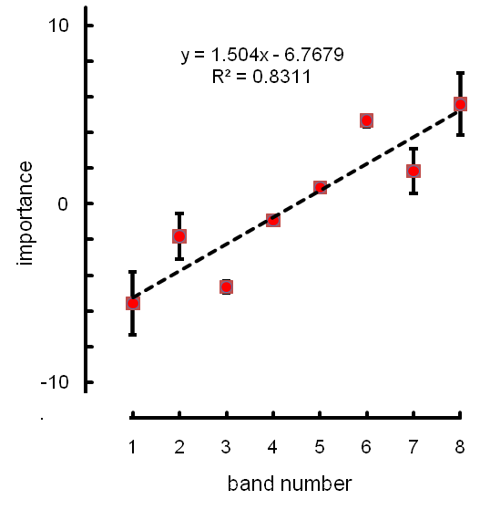
“sir” [sɜ], consonant & vowel ffts
20 dB
difference
consonant, [s]
vowel, [ɜ]
1
2
3
4
5
6
7
8
band no.
.125
.25
.5
1.
2.5
5.
frequency, kHz (log scale)

Slide 23
removing bands also gives a high-pass importance function
- effects are similar to adding reverb. (increasing distance)
suggests:
- effective contexts should have power in the important bands
- i.e. those bands where the [s] has most energy
might explain why some wide-band contexts are ineffective
(Watkins, 2005; Nielsen & Dau, 2010)
the alternative suggestion was:
- wide-band temporal envelope is too ‘smooth’
- so extra smoothing by reverb. is not apparent

Slide 24
8-band sparse-NV speech
for the 8 bands of the preceding context (‘next you’ll get …’);
- each band given the same, wide-band temporal envelope
→ ‘wide band’ condition
sound’s overall power; the same as other wideband contexts,
but here the energy is concentrated in the 8 bands,
so the spectrum level near the 8 centre-frequencies is higher

Slide 25

unprocessed
8-band
wide band
10
category boundary, step
5
0
.32
10.
.32
10.
.32
10.
context’s distance, m
both 8-band and wide-band contexts are very effective
and both give substantial constancy effects
so, ‘sharpness’ of temporal envelopes in 8-band conditions
- not too crucial

Slide 26
some other continua
- modulation depth varied as for sir-stir
- but here, substantial influence of onset characteristics
rose-roads
knees-needs
wash-watch
10
10
test dist.=10. m
10
test dist.=.32 m
category boundary, step
5
5
5
test dist. = 2.5 m
0
0
0
.32
2.5
10.
.32
2.5
10.
.32
2.5
10.
context’s distance, m

Slide 27
wash - watch
1.
context & test
near (0.32 m)
.5
0
1.
context near -
test far (10. m)
.5
proportion ‘wash’ responses
0
1.
context & test
far (10. m)
.5
0
0
5
10
continuum step

Slide 28
wash to watch continuum
- progressive increase in modulation depth
this has a substantial effect on test words’ identity
little or no effect of test-word reverb.
only small effects of the context’s reverb.
difficult to understand in terms of modulation processing;
- no apparent effects of reverb. on the test-word’s modulation
- little effect of anything resembling modulation masking
easy to understand in terms of reverberant ‘tails’
- onsets important for this distinction
- tails don’t affect onsets much

Slide 29
The idea that constancy precedes grouping of the vocoder’s bands is also consistent with the difficulties encountered by users of cochlear implants when they are in cocktail-party situations;
the grouping of the bands is largely of the type that comes after constancy, and so the factors responsible for this grouping are of limited utility in segregating sources (Nelson et al., 2003; Qin and Oxenham, 2003; Stickney et al. 2004).
A related finding is that interactions between reverberation effects and masking effects are less apparent with vocoder simulations than they are with unprocessed speech (Poissant et al., 2006).
This result-pattern seems to come about through the progressive scrambling of the fine-structure segregation cues as reverberation increases in unprocessed speech, which does not occur in vocoder simulations where these 'primitive' segregation cues are much less prevalent.

