Slide 1
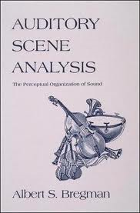
Bregman, A. S. (1990) Auditory Scene Analysis
(Cambridge, MIT)
discusses hearing in terms of perception,
e.g., similarity-based grouping → ‘streams’
engaging writing
perceptual ideas (Gestalt psychology) lack rigor
Handel, S. (2006) Perceptual Coherence
(New York, OUP)
theory firmer; incorporates statistical ideas
e.g., image decorrelation & efficient (sparse) coding
a thoroughgoing multidisciplinary account
challenging, but rewarding

Slide 2
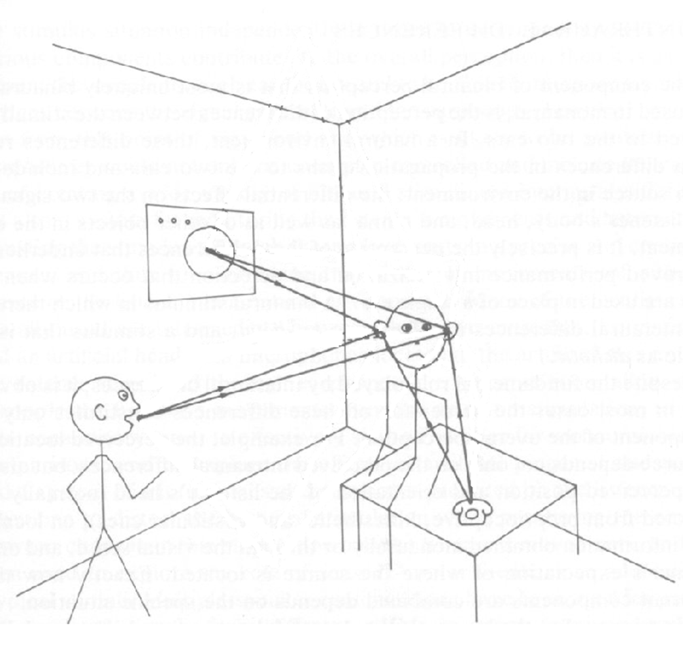
selection problem
similar problems at cocktail parties

Slide 3
grouping of sounds’ frequency components
components from the analysis at early stages of hearing
can be represented by ‘auditory scenes’:
frequency
time
components with similar onsets form separate groups
grouping alters what we hear, (as in ‘the whole ≠ sum of the parts’)

Slide 4
there are also sequential effects
two ‘streams’ (groups):
‘morse’
frequency
frequencies more similar; one stream:
‘horse’
time

Slide 5
sequential effects with melodies
O T H E R M E L O D Y S N O T E S
N O T E S O F O N E M E L O D Y
O T H E R M E L O D Y S N O T E S
pair 1
pair 2
one melody in a lower frequency range:
both melodies in similar frequency ranges:
notes interleaved in time:
frequency range is important for grouping and segregation
the name of one of the melodies in pair 2 is ‘frère jacques’
‘schemas’ (such as melody names) aid grouping, but not segregation

Slide 6
in speech, schemas seem to ‘fill in’ missing information
a consonant has been replaced by a cough
which one is it?
now there’s no cough, just a silent gap
is the task easier now?

Slide 7
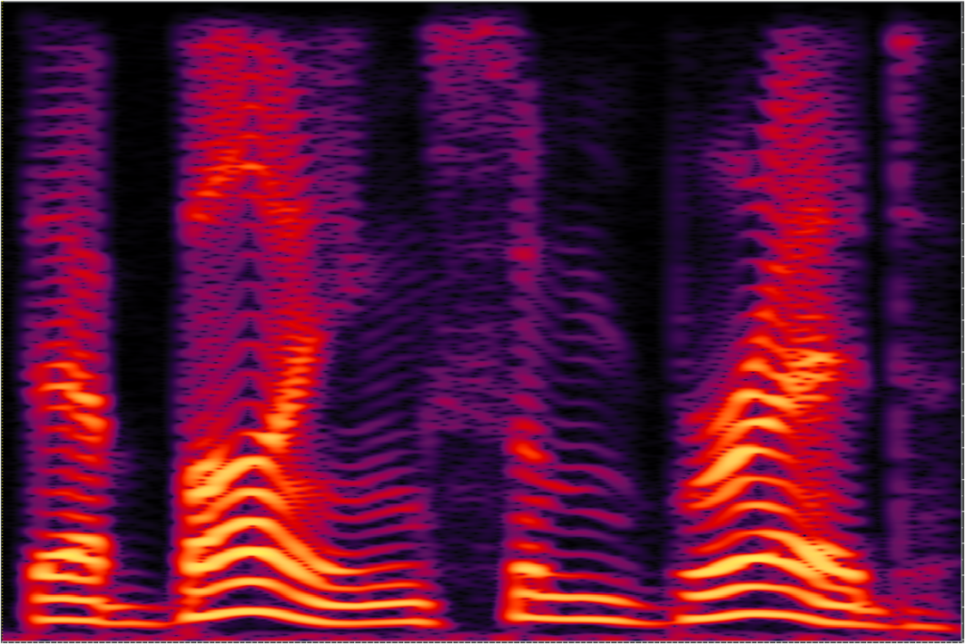
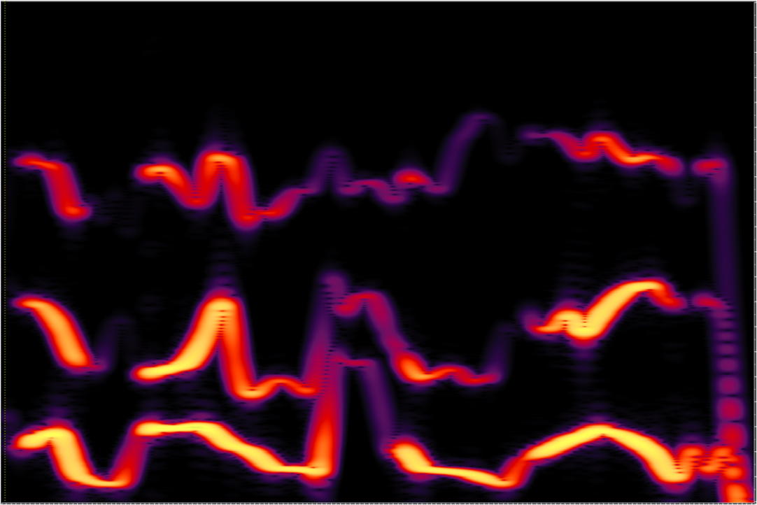
schema effects with sine-wave speech
original speech
sparse, sine-wave version
sine-wave speech
frequency
time
original: is it ? or ?
prior knowledge of the message helps ‘fill in’ missing parts
but, segregation of two or more talkers is impossible;
e.g., in cocktail parties where the partygoers speak ‘sine-wave’
Barker, J. & Cooke, M. P. (1999) Is the sine-wave speech cocktail party worth attending?
Speech Communication, 27, 159-174.

Slide 8
visual perception ‘takes account’ of lighting conditions

Slide 9
‘taking account’ gives perceptual ‘constancy’
lighting effects are clearly visible,
- but tend to be ignored

Slide 10
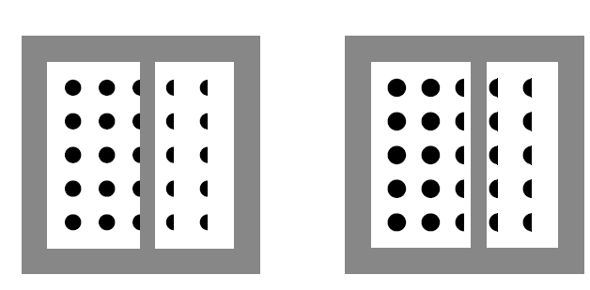
visual-shape constancy and grouping
grouping after constancy
grouping before constancy
as with schemas, grouping after constancy does not aid segregation
Palmer, S.E. Brooks, J.L. & Nelson, R. (2003)
When does grouping happen? Acta Psychologia, 114, 311-330

Slide 11
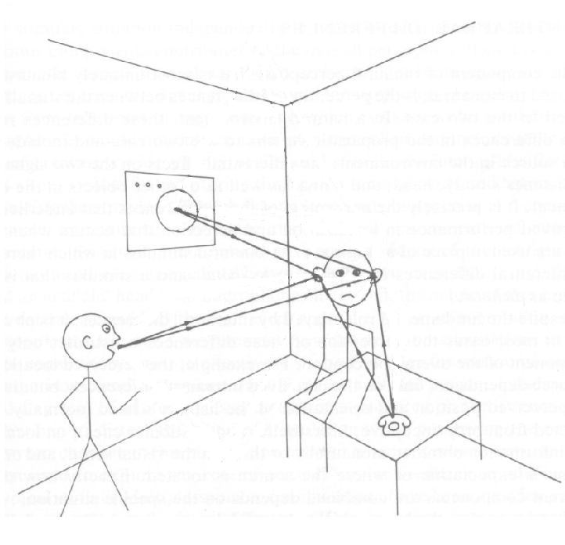
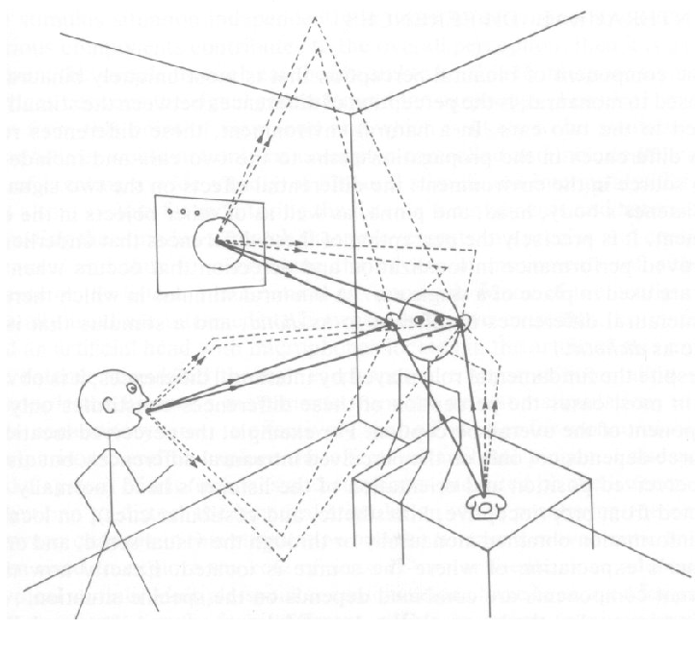
constancy seems to be necessary in hearing

Slide 12
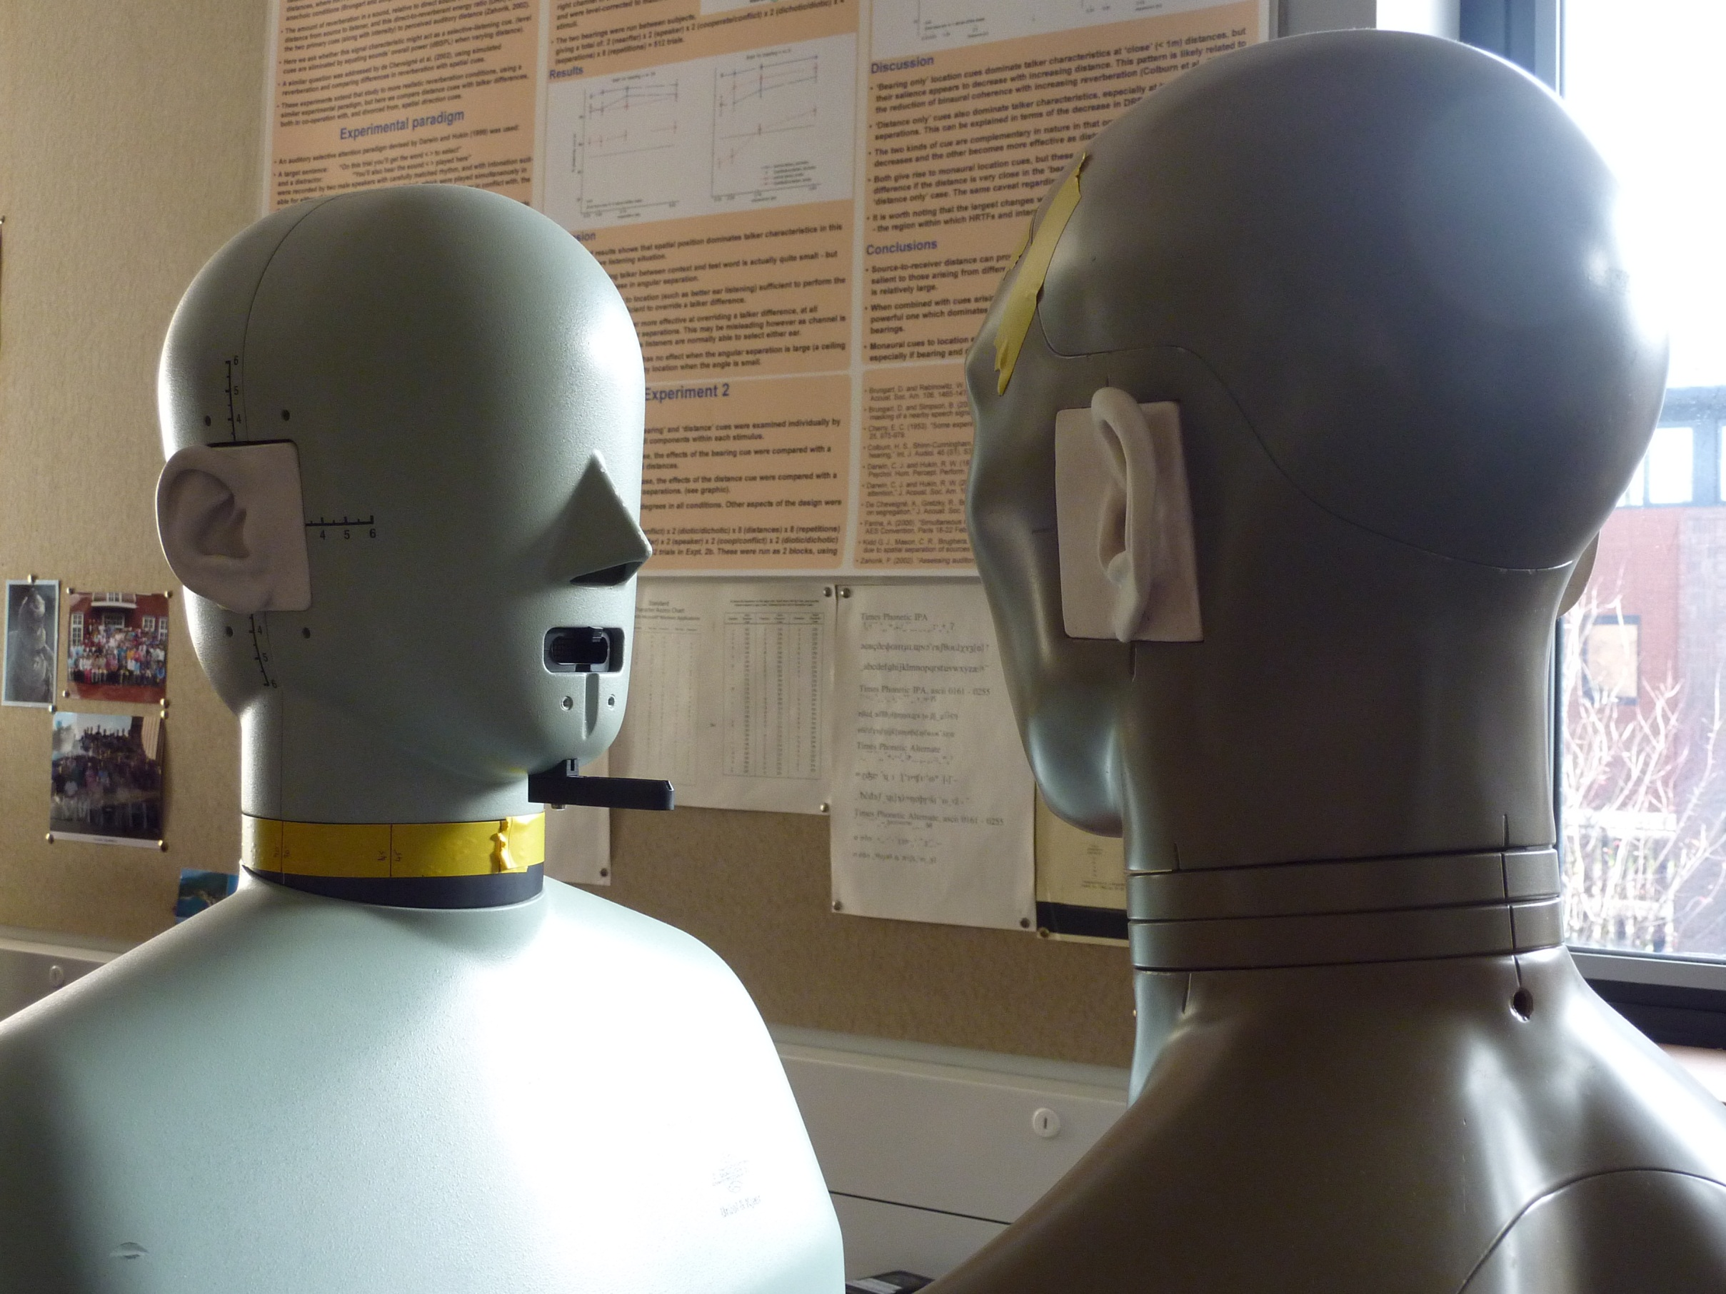
rooms’ reflection-patterns from their ‘impulse responses’
in effect, these are an impulsive sound,
e.g., a brick struck by a hammer,
played and recorded in different positions about the room
the human head casts sound ‘shadows’
so mannequin heads are used (Photo courtesy A Beeston):
mike
(inside)
speaker

Slide 13
room impulse responses (from Reading Auditory Lab.)
direct sound
reflections, ‘tail’
near, small
longer tail
far, large
amplitude
100 ms
time

Slide 14
effects of ‘tails’ at ends of sounds
resemble effects of lighting conditions in some respects:
- the contribution of tails tends to be ignored when listeners
judge sounds’ loudness in rooms (Andrew Raimond’s work)
- cues from tails tend to be ignored in perceptual selection
among messages heard in rooms (Simon Makin’s work)
but are tails taken into account in speech perception,
so that they give constancy effects?

Slide 15
constancy of phonetic perception seems to be effective
“slay” near
“splay” near
amplitude
tail, from [s]
“splay” far
500 ms
time

Slide 16
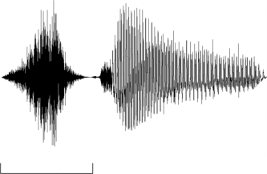
lab. study using ‘sir’ vs. ‘stir’ test words
distinguished by the gap in ‘stir’ before voicing onset
11-step continuum
end-point ‘stir’ (step 10)
from amplitude modulation of other end-point, ‘sir’ (step 0)
prominent effect of this AM is the gap
intermediate steps, 1-9, by varying modulation depth
AM function
amplitude
‘sir’
‘stir’
step 0
step 10
200 ms
200 ms
time

Slide 17
perceptual effects of room reflections
apply impulse responses to sounds
vary their distances
listeners identify these test words
measure category boundary:
‘extrinsic’ context:
“next you’ll get _ to click on”
increase test-word’s distance:
more ‘sir’ responses, which increases category boundary
increase context’s distance as well:
perception seems to take account as there’s a ‘constancy’ effect i.e.,
fewer ‘sir’ responses, which restores category boundary
1.
mean category boundary
mean proportion of ‘sir’ responses
.5
0.
0
5
10
“sir”
“stir”
continuum step

Slide 18
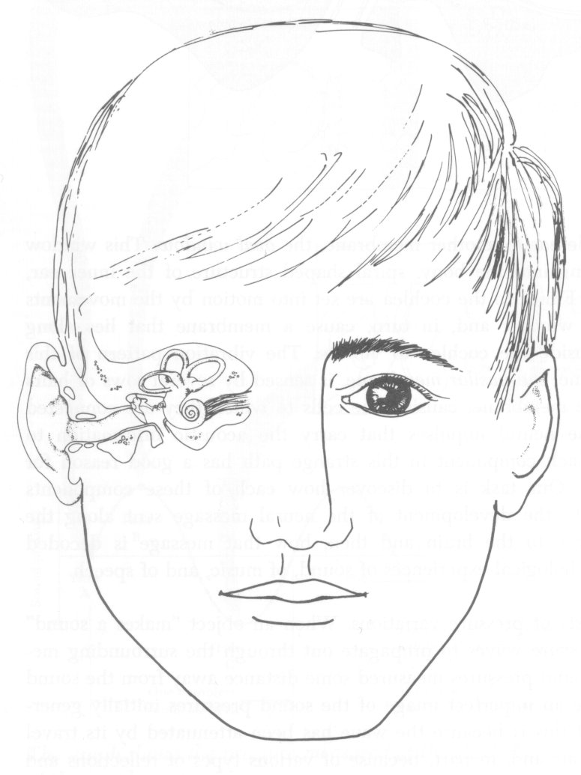
cochlear implants
speech + music
cochlea
music
middle ear
unprocessed:
middle ear
simulation:
inner ear, cochlea
mike
higher
middle ear
frequency components
auditory nerve’s fibres
basilar membrane
inner ear, cochlea
outer ear
higher
auditory nerve,
≈ 25,000 fibres
lower
frequency components
narrowband filters (electronic)
auditory nerve’s fibres
basilar membrane
Shannon, R. V., Zeng, F., Kamath, V., Wygonski, J. and Ekelid, M. (1995)
Speech recognition with primarily temporal cues Science 270, 303–304.
lower

Slide 19
how are implant simulations made?
simulations from ‘noise-excited vocoders’ are considered realistic
here, a few (e.g., 8) noise bands are used
bands from different centre-frequencies are added together
the result is ‘sparse-NV’ speech
level fluctuations in a speech band
same fluctuations in a narrowband noise
frequency
time

Slide 20
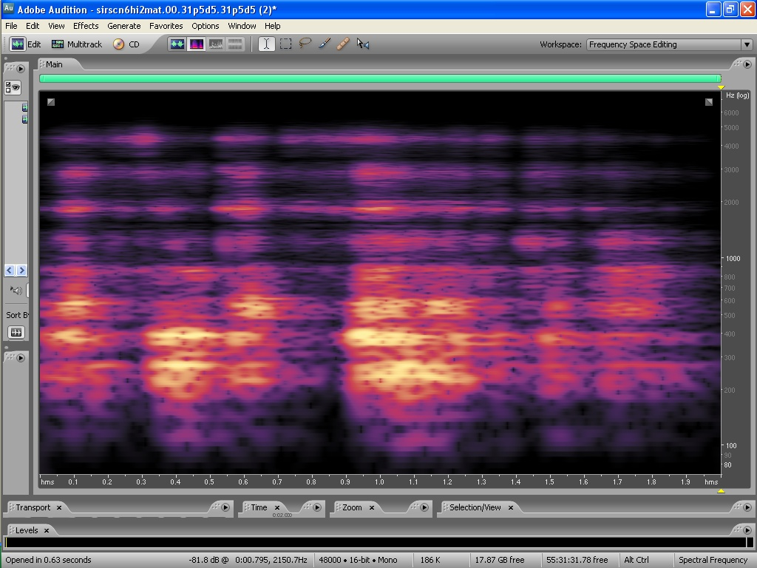
constancy experiments with sparse-NV speech
speech of contexts and test words
processed with an 8-band noise-excited vocoder
band centre-frequencies increase with the band number, n
4.
8
7
step 10
2.
6
5
grouping effect
1.
frequency, kHz (log scale)
4
.5
3
2
.25
1
step 0
n
300 ms
‘sir’
time

Slide 21
grouping before
constancy:
or
grouping after a ’band-by-band’ constancy:
✓
constancy
“stir”
“stir”
grouping
grouping
constancy
grouping
8
6
band number
(centre frequency)
4
2
context
test word
context
test word
constancy in these sounds, that seems to precede grouping
consistent with a grouping that depends on speech schemas
so cocktail parties won’t be so enjoyable for implant users
although they might show constancy effects …

