Slide 1
Loudness asymmetry in real-room reverberation: cross-band effects
Andrew P Raimond, Anthony J Watkins

Slide 2
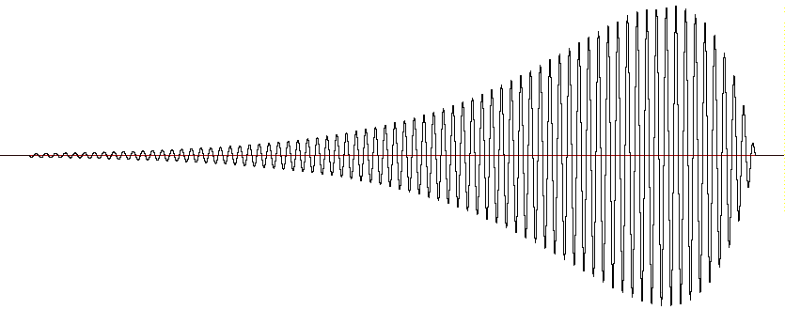
loudness asymmetry effect (Stecker, 1995)
‘ramped’ tones:
judged to be louder
than ‘damped’ tones:
amplitude
100 ms
time
amplitude
100 ms
time

Slide 3
loudness context effect, (Stecker & Hafter, 2000)
test tone’s loudness compared w/ a preceding ‘standard’ tone
standard tones were either ramped or damped, giving 4 pairings:
standard
test
ramped
ramped
small
loudness
difference
damped
like “tails” from room-reflections; don’t contribute to “source’s” loudness
amplitude
damped
ramped
bigger
loudness
difference
damped
100 ms
time

Slide 4
two questions about loudness context effects
reflection patterns in real rooms typically give longer ‘tails’
- are these effects still apparent for sounds with such tails?
‘cross-band’ conditions:
- if listeners compare standards and tests with different frequencies,
are there still loudness context effects?

Slide 5
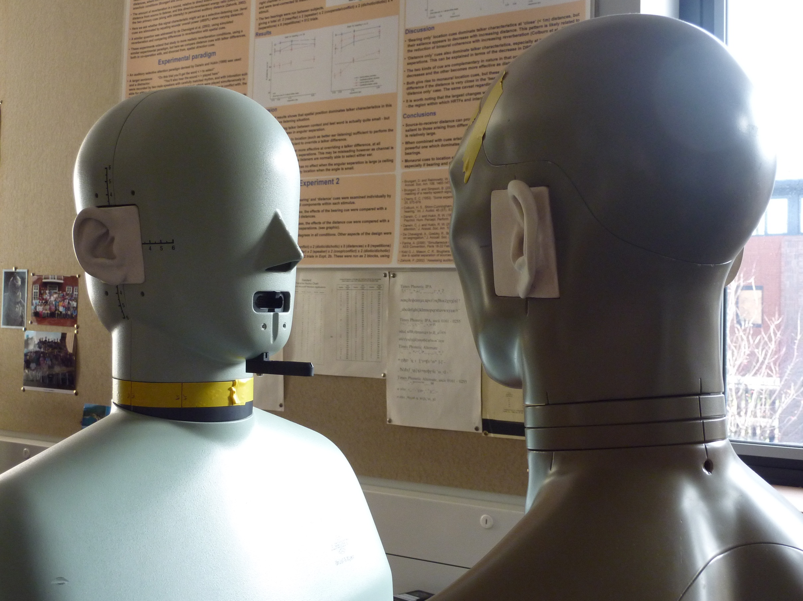
real-room reflection pattern
recordings:
- in a room, volume = 130.8 m³
- dummy-head transducers
- facing each other
- 2.5 m apart
room’s impulse response (RIR):
- obtained with the sine-sweep method (Farina, 2000):
- early (50 ms) to late energy ratio = 9.7 dB, A-weighted
- A-weighted energy decay rate = 60 dB per 600 ms
when such RIRs are convolved with ‘dry’ sounds:
- effects monaural ‘real-room’ listening with headphone presentation
speaker
listener

Slide 6
‘real-room’ versions of ramped and damped tones
ramped tone
real-room’s impulse-response
convolve
with
amplitude
100 ms
time
real-room damped tone
real-room ramped tone
reverse
amplitude
500 ms
time

Slide 7
method with standard & test at same frequency
pairings with standard & test tones both at 300 Hz or both at 1500 Hz
standard tone at 80 dB SPL
30 repeats of 9 test-tone levels, symmetrically placed around 80 dB SPL
listeners asked; was test louder or quieter than the preceding standard?
‘loudness index’ for each standard and test pairing:
- count the number of times listeners said “louder”
then divide by 270 (30 x 9) to give a proportion;
higher values indicate louder test tones

Slide 8
standard & test at same frequency;
real-room data, 4 listeners
ramped test
damped test
tones at 300 Hz
tones at 1500 Hz
loudness index
ramped standard
damped standard
ramped standard
damped standard
loudness difference between ramped and damped test tones
- small for ramped standards
- bigger for damped standards

Slide 9
standard & test at different frequencies;
real-room data, 4 listeners
ramped test
damped test
300 Hz standard
1500 Hz test
1500 Hz standard
300 Hz test
loudness index
ramped standard
damped standard
ramped standard
damped standard
loudness difference between ramped and damped test tones
- again, small for ramped standards
- but now, similarly small for damped standards

Slide 10
conclusions
the loudness context effect is still apparent when sounds’ ‘tails’ are generated with real-room reflection patterns
this is seen when the test sound and preceding standard are both at 300 Hz, as well as when they’re both at 1500 Hz
when standard & test are at different frequencies, the context effect is markedly reduced
this indicates that the influence of the ‘tails’ in these standards is confined to their frequency-vicinity
a similar frequency-specificity is found in perceptual compensation for reverberation in speech perception (Watkins et al. 2011);
- in both cases, the salience of tails is reduced in ‘real-room’ contexts
- so both effects might arise from the same perceptual mechanism

