Slide 1
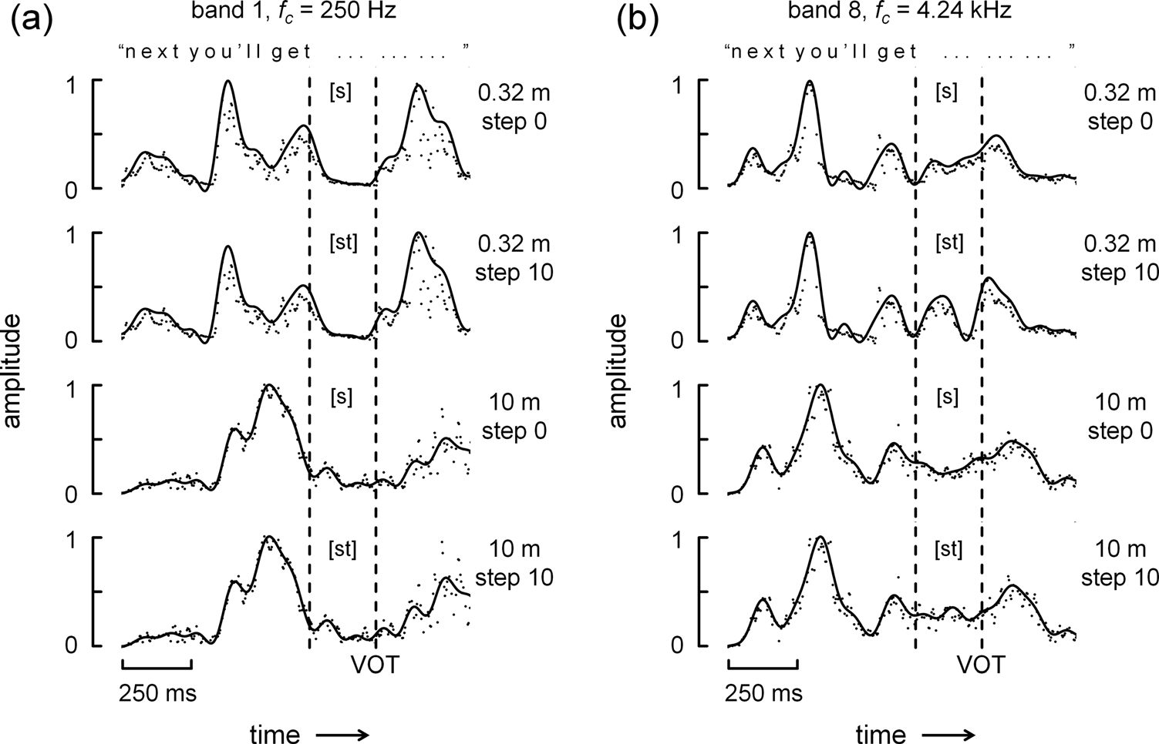
Watkins, Raimond & Makin (2011) J Acoust Soc Am 130 2777–2788
temporal envelopes in auditory filters:
[s] vs [st] distinction is most apparent;
- at higher fc
- and at nearer distance
FIG. 2. The traces are temporal envelopes in narrow frequency-bands of test words from the continuum’s “sir” [s3] and “stir” [st3] end-points along with the preceding part of the context, “next you’ll get….” The speech was first convolved with the left channel of a binaural room impulse response (BRIR) obtained with a source to receiver distance of 0.32 m (upper two rows) or 10 m (lower two rows). These sounds were then played through an auditory filter with a center frequency, f_{c}=250 Hz (a) or f_{c}=4.24 kHz (b), followed by full-wave rectification and then lowpass filtering with corner frequencies of 50 Hz (points) or 10 Hz (continuous traces). The interval occupied by the test-word’s [s] or [st] frication lies between the vertical dashed lines, which are the start of the test word (left-hand line) and voice-onset time (VOT) in the original dry recording.

Slide 2
A tail attenuator:
low-pass
10 Hz
time
differential
auditory
filter
full-wave
rectify
attenuate
low-pass
50 Hz
low-pass
10 Hz

Slide 3
attenuation
band 8, f_{c} = 4.24 kHz
0 dB
“n e x t y o u ’ l l g e t . . . . . . . . . ”
-12 dB
1
[s]
0.32 m
step 0
0
1
[st]
0.32 m
step 10
0
amplitude
1
[s]
10 m
step 0
0
1
[st]
10 m
step 10
0
VOT
250 ms
time

Slide 4
this sort of tail attenuation
- reduces the mean
- emphasises onsets
- has a high-pass effect on the signal’s modulation
computationally, almost trivial:
- e.g. in C, Fortran etc.
- or in ‘neural’ circuitry

Slide 5
band 8, f_{c} = 4.24 kHz
“n e x t y o u ’ l l g e t . . . . . . . . . ”
1
[s]
0.32 m
step 0
0
1
[st]
0.32 m
step 10
0
amplitude
1
[s]
10 m
step 0
0
1
[st]
10 m
step 10
0
VOT
250 ms
time

